Slide 1
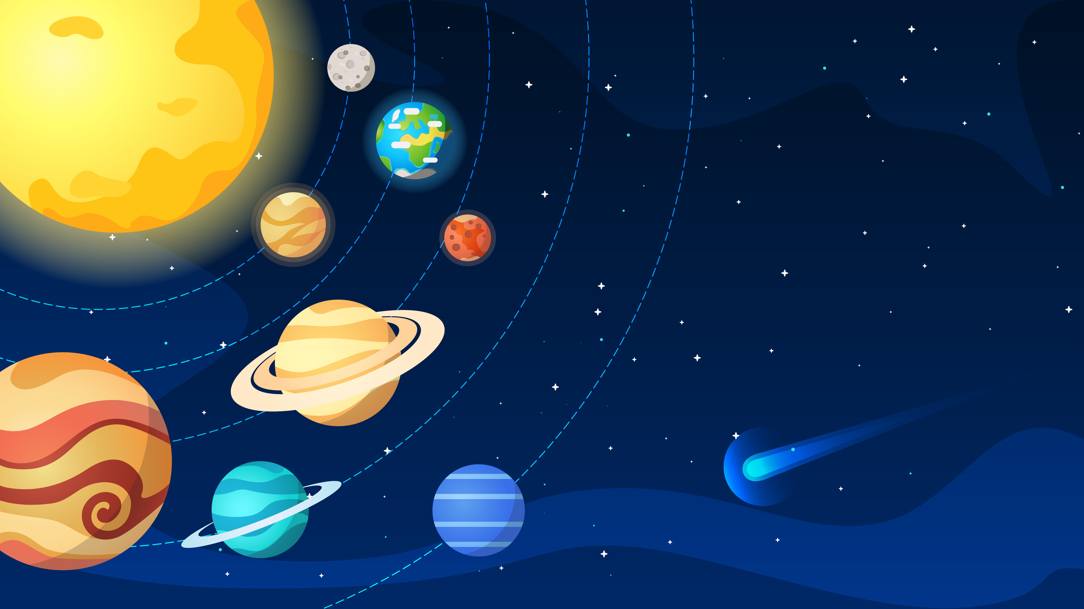
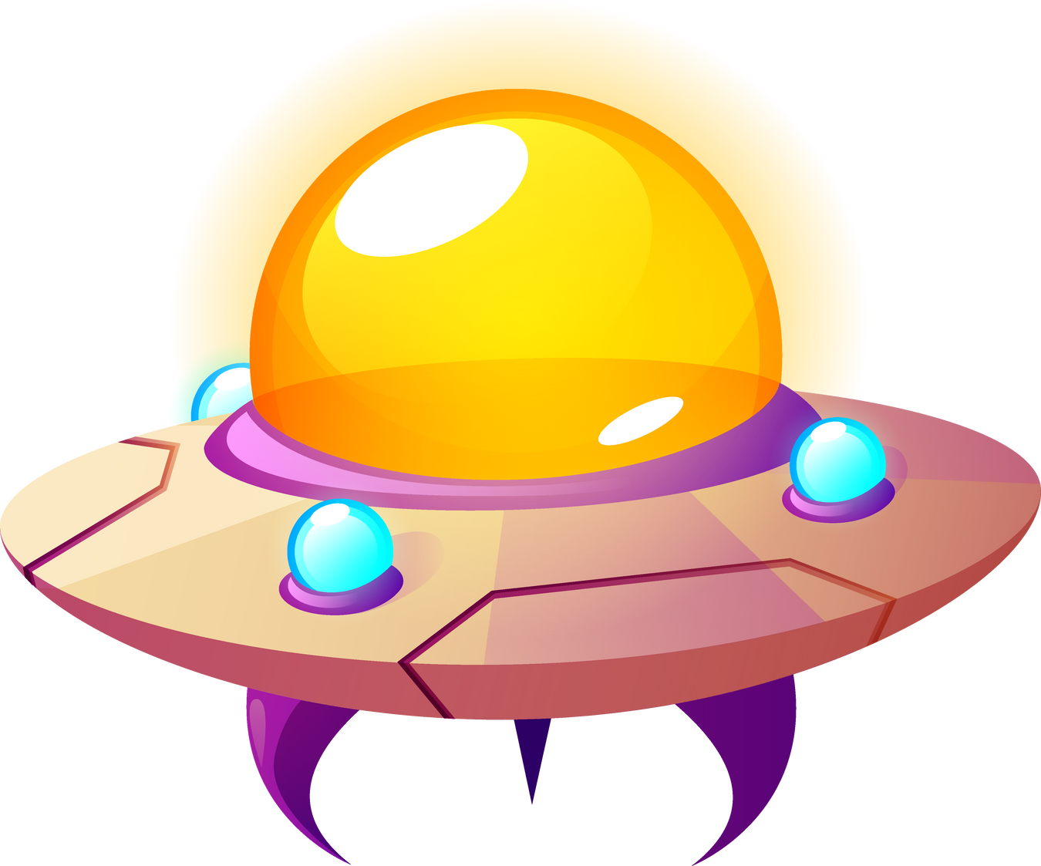
ARTS OF SCİENCE
The Silent Danger of Space: The Impact Power of Meteors

Slide 2

PROJECT SUMMARY
Our goal is to convey the impact of meteors on Earth, as well as concepts such as space, planets, and exoplanets, to children ages 10-15 in a fun and educational way. We used stop-motion videos, Minecraft videos, e-books, and Kahoot activities to make NASA's open data accessible, engaging, and memorable.

Slide 3
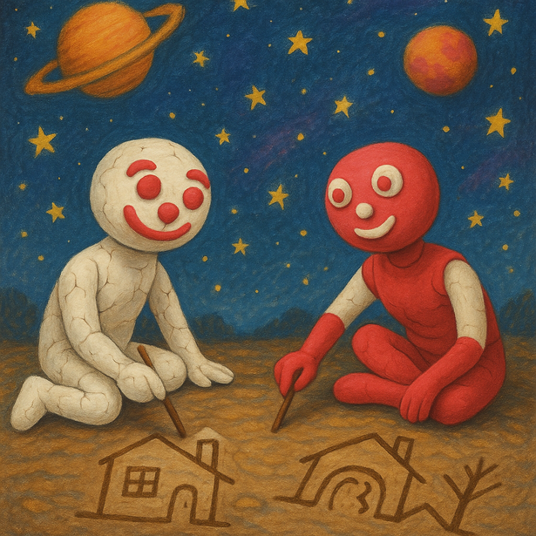
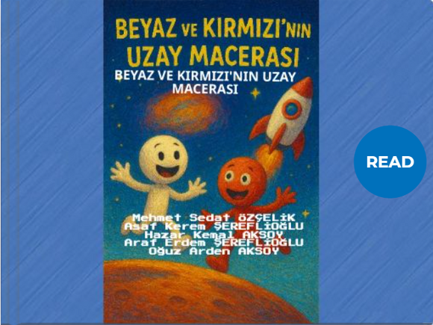

Project Internet Address
https://artsofscience.icodeflow.com/

Slide 4
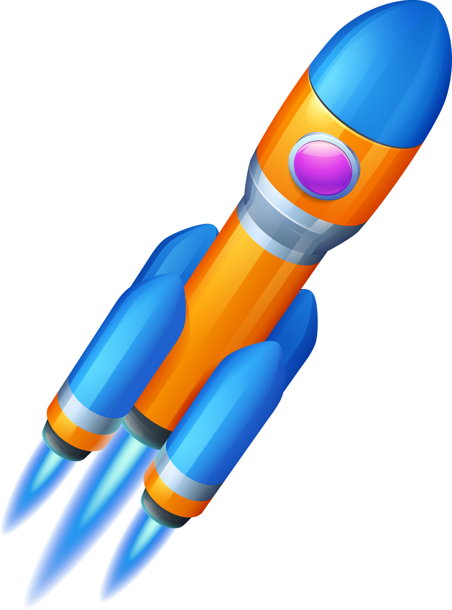
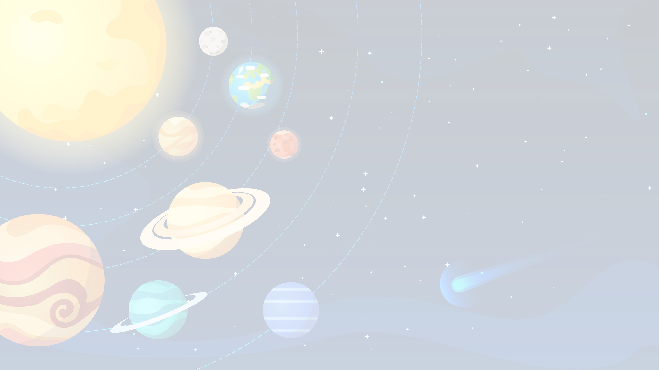
Project Description
The primary goal of the study is to use NASA's open data resources to convey to children the potential impacts of meteors hitting Earth (e.g., tsunamis, pressure waves, climate change) in an understandable, entertaining, and educational manner. Furthermore, the aim is to introduce concepts of space, planets, exoplanets, and basic astronomy using engaging methods. The key approach here is to transform abstract and complex scientific data from purely academic content into a practical, practical, and age-appropriate learning experience. Rather than simply transferring knowledge, the project prioritizes children's active participation, their participation in the production process, and their ability to retell science from their own perspective.

Slide 5
Project Description
Our team consists of five students aged 8-11 and a team leader. The participants designed and implemented the project using a "children's perspective" approach. In the first phase, they prepared meteorite models using play dough and baking white and red stick figures. The background was created using recycled materials, and animation scenes were drawn using stop-motion techniques. Then, they designed a spacescape of their own imagination on the Minecraft platform. Short videos were recorded based on this design, and the content was dubbed into English by Rask AI and then shared on YouTube. In another phase of the project, an e-book was created using StoryJumper, with visuals generated with AI support, and text created using ChatGPT and translated using Google Translate. To ensure learning retention, an interactive quiz based on the e-book's content was created on the Kahoot platform, allowing students to reinforce their knowledge through gamification. All of this content was compiled and made accessible on the project's public website.

Slide 6
Project Description
As a result, the project transformed the scientific aspects of meteors and space beyond mere technical knowledge into a creative, playful, and participatory learning process that stimulates children's curiosity. Thus, NASA's open data was reinterpreted to strengthen children's access to scientific knowledge, their ability to interpret it, and their ability to connect it to daily life. The study demonstrates the feasibility of an interdisciplinary approach to science education for children and offers a model applicable to similar age groups in the future.

Slide 7
Source
  https://www.spaceappschallenge.org/2025/find-a-team/get-to-know-them/?tab=project
  https://meteor.icodeflow.com/
  https://chatgpt.com/
  https://www.storyjumper.com/library/my
  https://play.google.com/store/apps/detailsid=com.cateater.stopmotionstudio&hl=tr
  https://app.rask.ai/spaces/1a47ed78-7203-4121-9867-efc214536dff
  https://www.capcut.com/tr-tr/tools/desktop-video-editor
  https://www.minecraft.net/tr-tr
  https://create.kahoot.it/share/uzayn-sessiz-tehlikesi-meteorlarn-carpma-gucu/f7235d61-68bc-426f-b49a-2f31a6b513c2
  https://www.canva.com/
Thanks!

